Slide 1
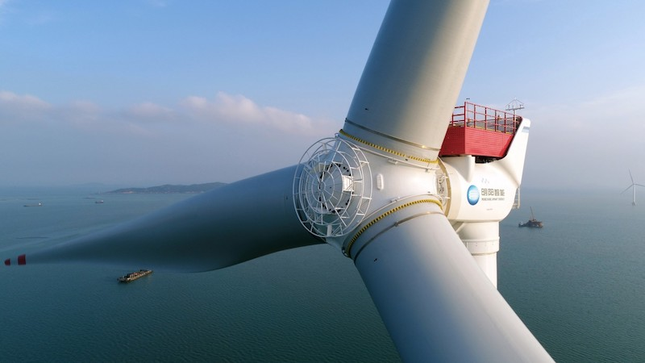
The best energy source
Wind Energy
Solar Energy
Fossil Fuel
Nuclear energy
Better Nuclear energy

Slide 2


Watch out bro!!
Whats that?...
Wee!!
Wind Energy
Solar Energy
Fossil Fuel
Nuclear energy
Better Nuclear energy

Slide 3
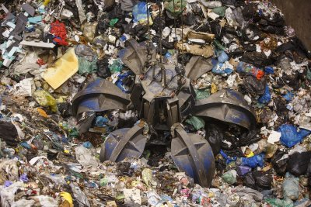

Wind Energy
Solar Energy
Fossil Fuel
Nuclear energy
Better Nuclear energy

Slide 4
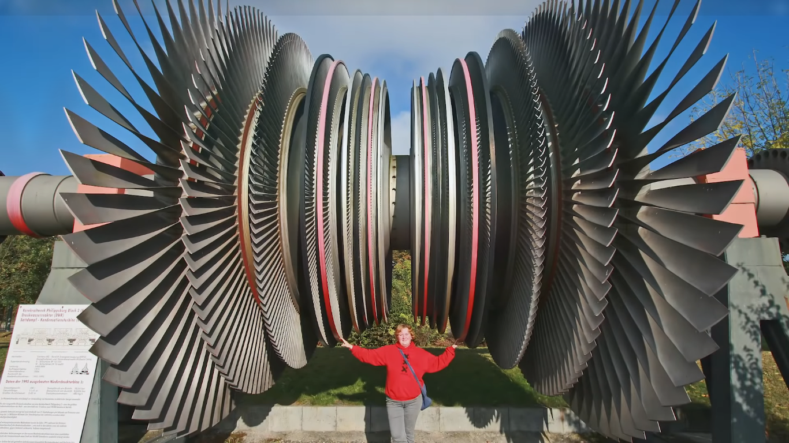
Wind Energy
Solar Energy
Fossil Fuel
Nuclear energy
Better Nuclear energy

Slide 5
Wind Energy
Solar Energy
Fossil Fuel
Nuclear energy
Better Nuclear energy

Slide 6
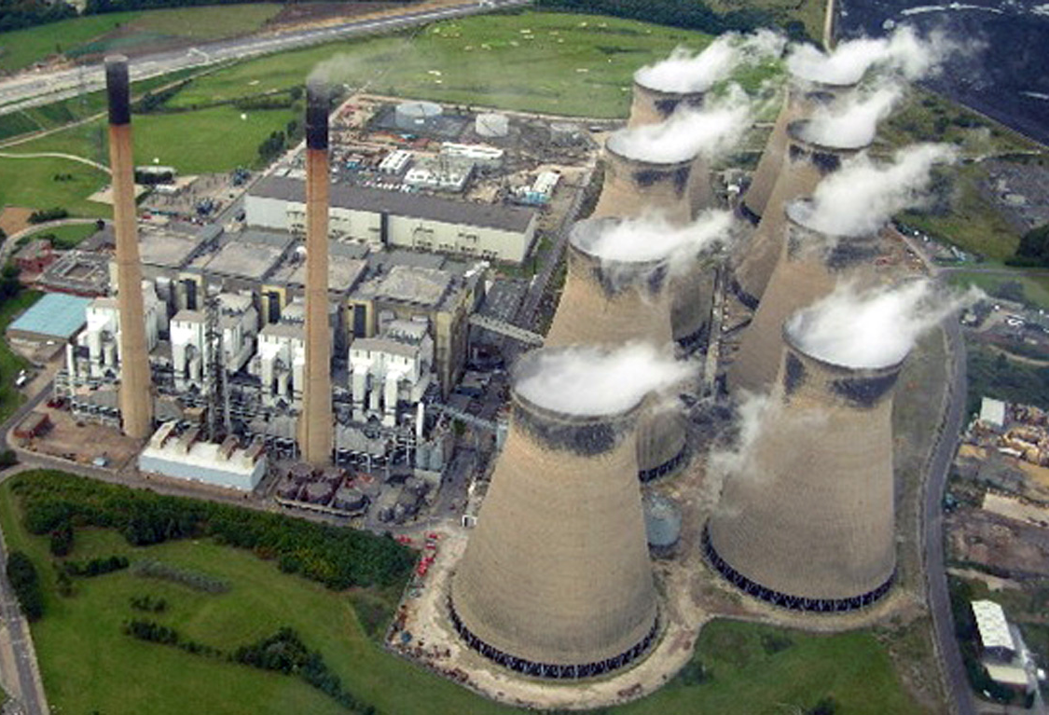
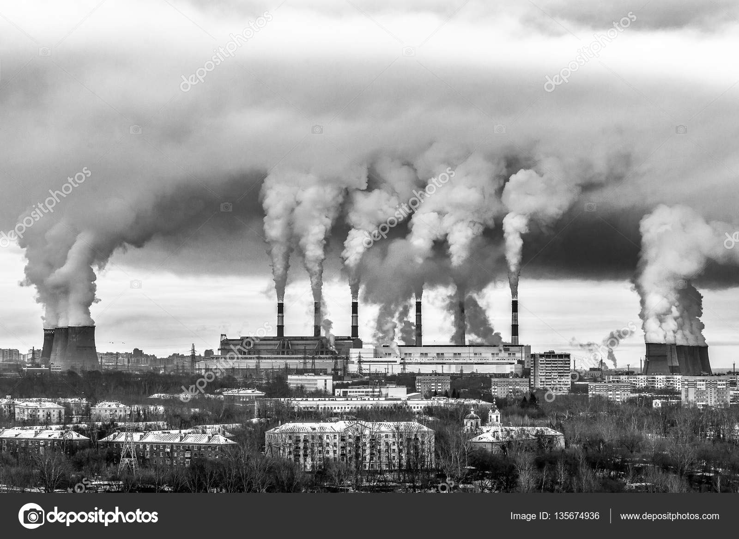
Wind Energy
Solar Energy
Fossil Fuel
Nuclear energy
Better Nuclear energy

Slide 7
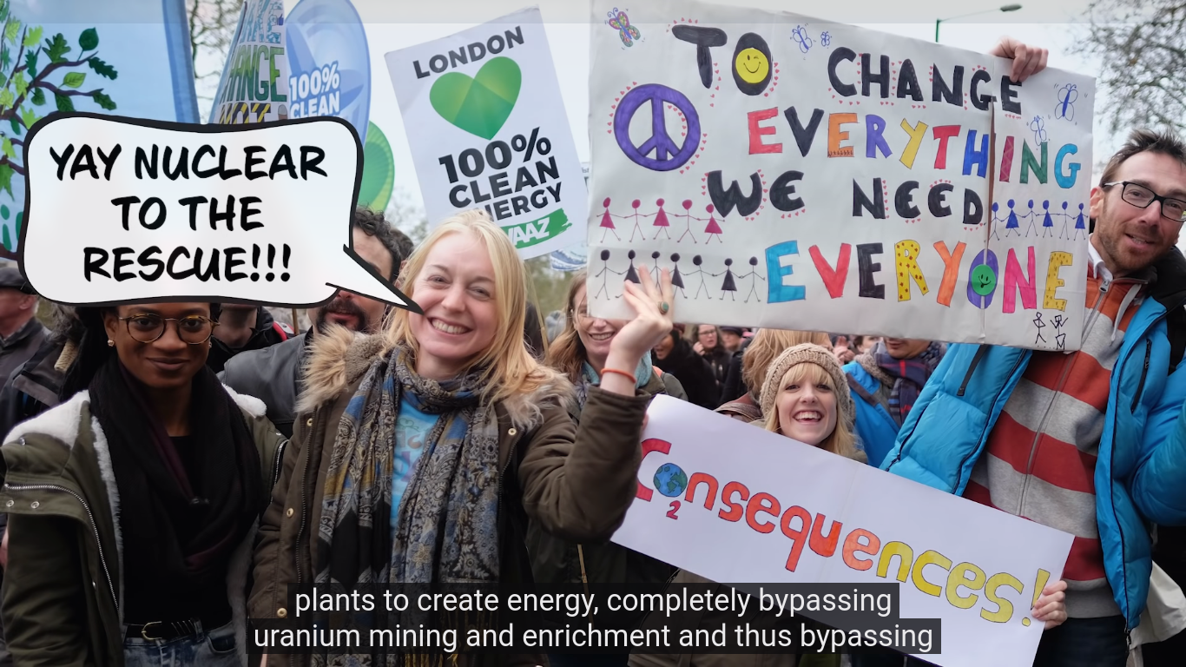
Wind Energy
Solar Energy
Fossil Fuel
Nuclear energy
Better Nuclear energy

Slide 8
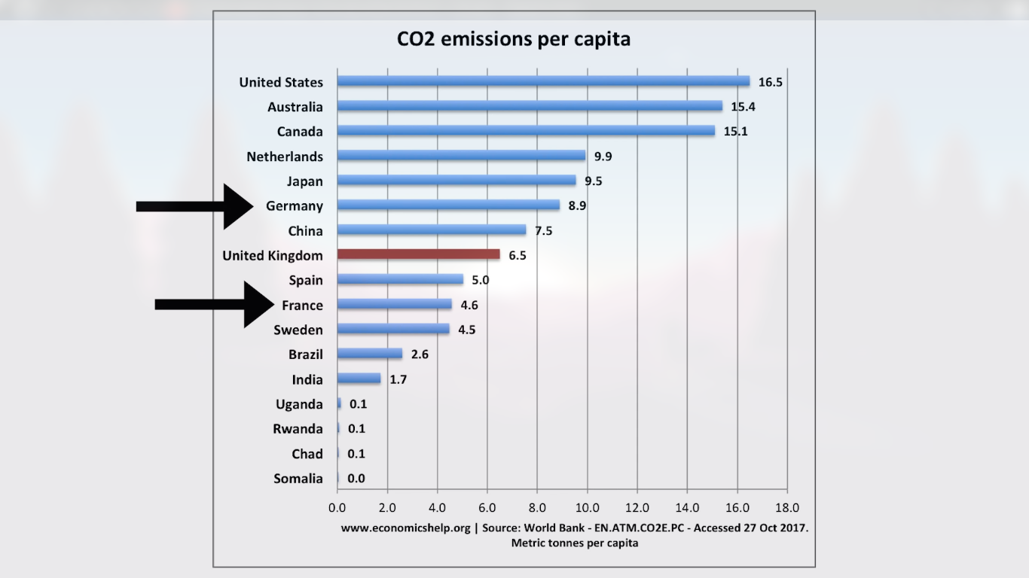
Wind Energy
Solar Energy
Fossil Fuel
Nuclear energy
Better Nuclear energy

Slide 9
Gotta Go, Byee!!!
-Akhilesh

